Slide 1


DATA SCIENCE PROJECT
GROUP 2
CHARLES ADESANYA
CHUKWUKA ILONWA
DORIS OGBU-NNACHI

Slide 2

DATASET USED: SALES DATA OF A RETAIL STORE
This project;
Analyses and visualizes the sales data
Builds a machine learning model to predict future sales revenue.
The dataset contains information on transactions, including product categories, units sold, unit prices, and regions.

Slide 3
PROCESS OF DATA USAGE
Importing Necessary Libraries
Load the Dataset
Data Preprocessing
Data Visualization
Machine Learning Model
Future Predictions

Slide 4
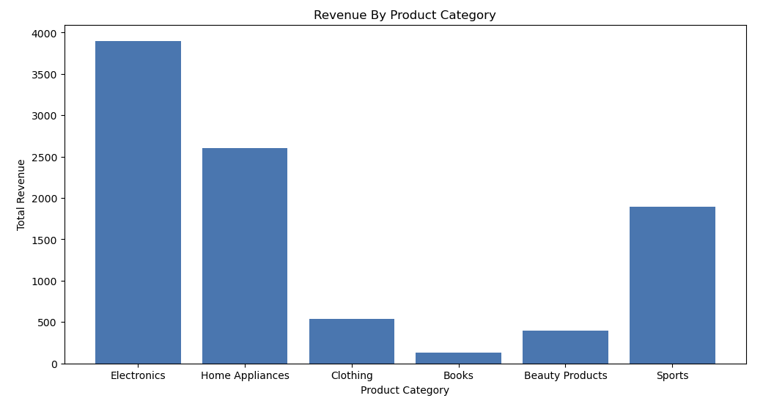
Relationship Between The Product Category And Total Revenue

Slide 5
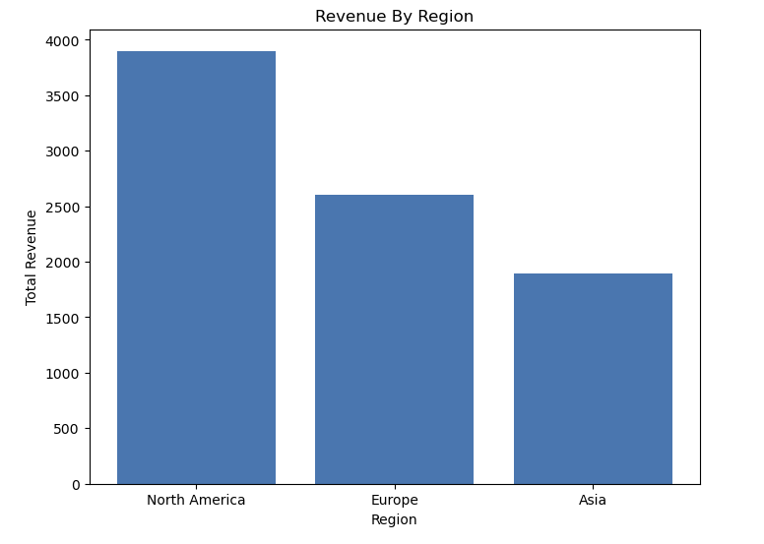
Relationship Between The Region And Total Revenue

Slide 6
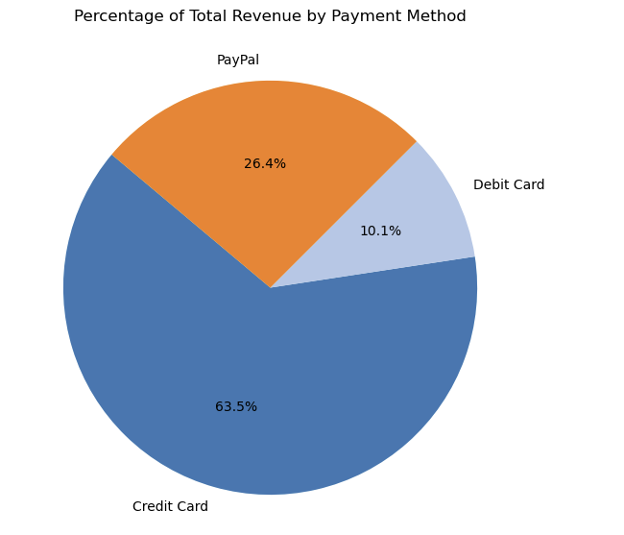
Payment Distribution Using A Pie Chart

Slide 7
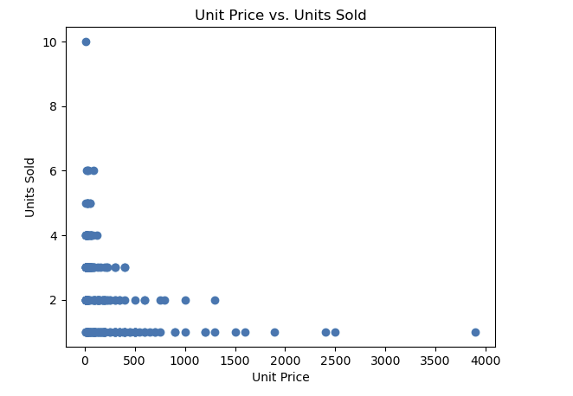
Relationship Between The Units Sold And The Unit Price

Slide 8
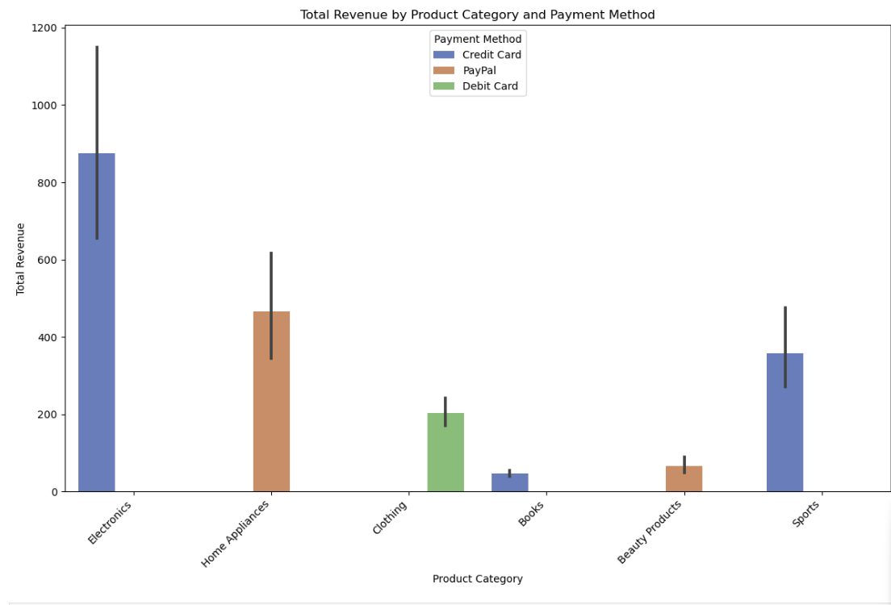
Total Revenue Breakdown By Product Category And Payment Method

Slide 9
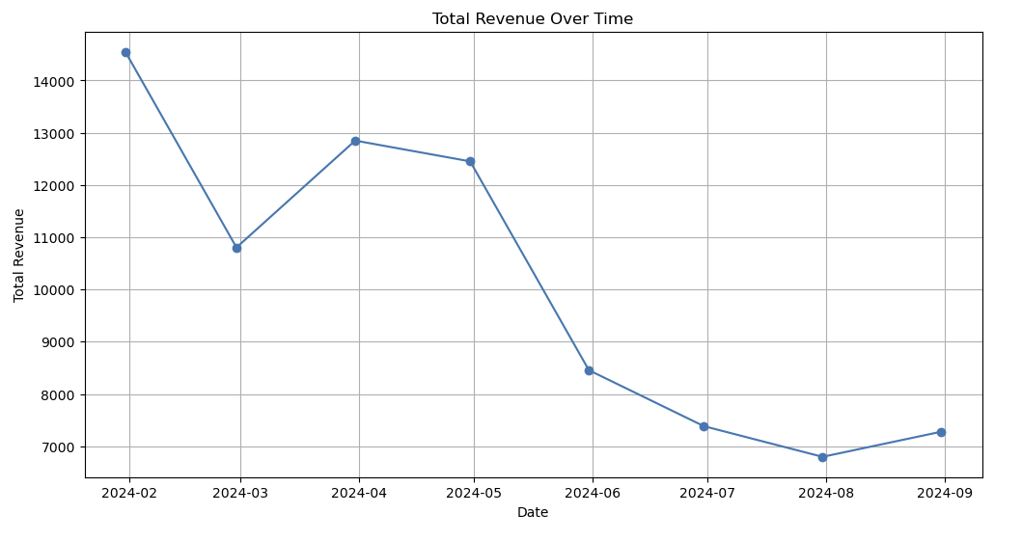
Line Plot For Total Revenue Over Time

Slide 10
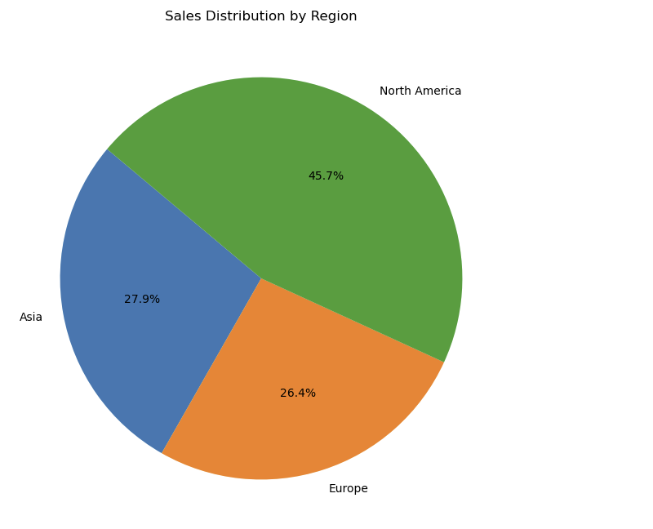
Pie Chart of Sales Distribution by Region

Slide 11
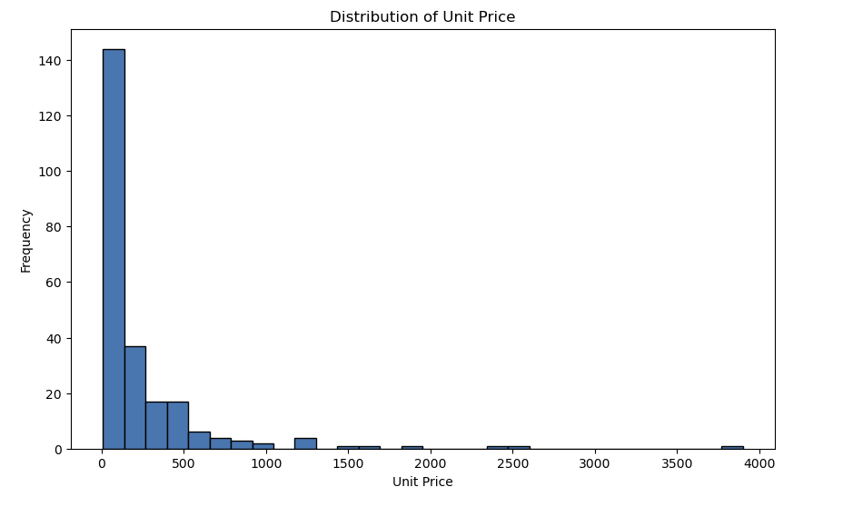
Histogram of Unit Price

Slide 12
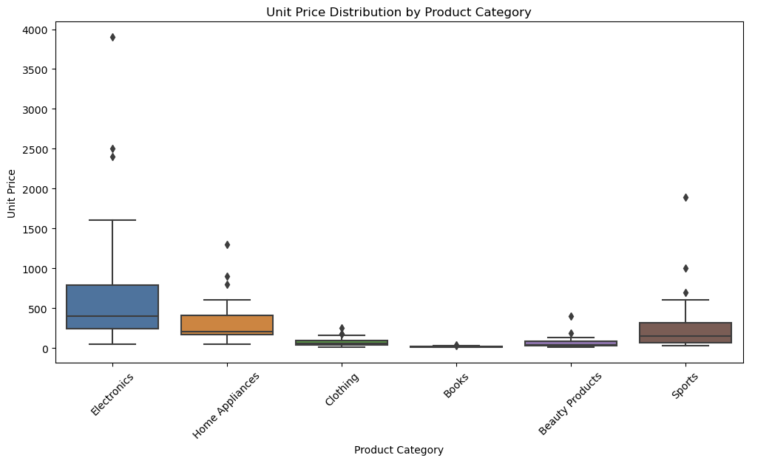
Box Plot of Unit Price by Product Category

Slide 13
Machine Learning Model for Prediction
Machine Learning Model:
Linear regression to predict Total Revenue using features such as date, product category, unit sold, unit price, region, and payment method.
Model evaluation using Mean Squared Error (MSE).
Mean Squared Error: 19752.625269746273

Slide 14
Prediction For The Rest Of The Year
Date Predicted Total Revenue
0 2024-09-30 225.732862
1 2024-10-31 202.686131
2 2024-11-30 180.382843
3 2024-12-31 157.336112

Slide 15
The output from the predictions for the future months shows a noticeable downward trend in the predicted total revenue from September to December 2024. Several potential reasons could explain this pattern:
Seasonality
Insufficient Data Representation
Trends in the Data
Model Limitations
Economic Factors

Slide 16
THANK YOU

